Slide 1

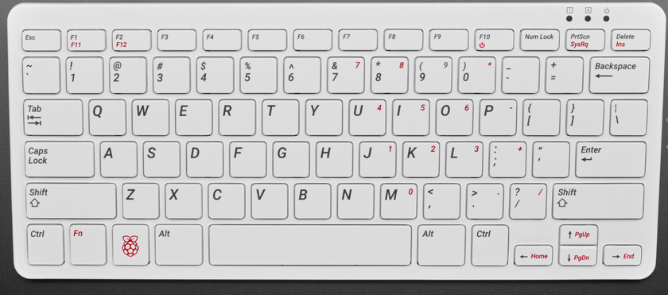
Basic Raspberry Pi and I2C Sensors
By Chuck Duey
September 22nd, 2021
TM Raspberry Pi Foundation www.raspberrypi.org

Slide 2
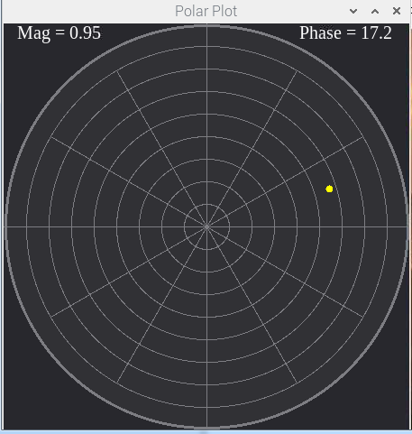
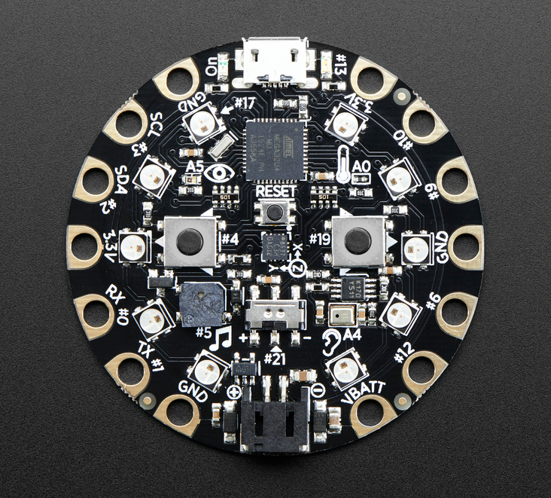
Outline:
TM Raspberry Pi Foundation www.raspberrypi.org
Your project and programming
Different embedded systems
Raspberry Pi Versions.
Installation and setup of a Raspberry Pi.
Useful tools for use with Raspberry Pi
Desktop Tour of the Raspberry Pi
Raspberry Pi Packages
Downloading and running programs on the Raspberry Pi
Raspberry Pi IO
Add on Hats, Bonnets and USB devices with Demos
The I2C bus Demo.

Slide 3
Think About the Scope of Your Project
Many projects try to reach too far. Start simple and improve over the semester.
Think a little ahead on what might be wanted. For example, it is easier to get a board with Wi-Fi than add it later.
Does your project need analog I/O? Some systems have it built in, other need addon boards.
Hardware is only part of the picture; most projects need more time to write and debug the software.
When possible, have two of any critical hardware piece. At the last minute, hardware breaks or gets damage.
Do not procrastinate!

Slide 4
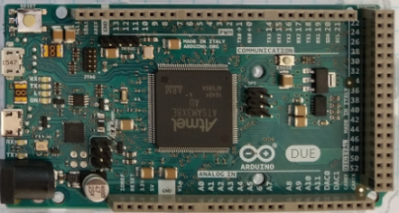
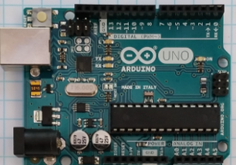
Arduino
Advantages
Many different I/O’s built-in including ADC.
Very nice IDE. (Integrated Development Environment)
Huge opensource community for both hardware and software.
Many premade shields and hardware addons.
Disadvantages
ADC lower resolution and slow. Difficult to do audio speeds.
Need to get a Wi-Fi/BT version in advance, or add on for IOT
Not easy to get a high-resolution dynamic display.

Slide 5
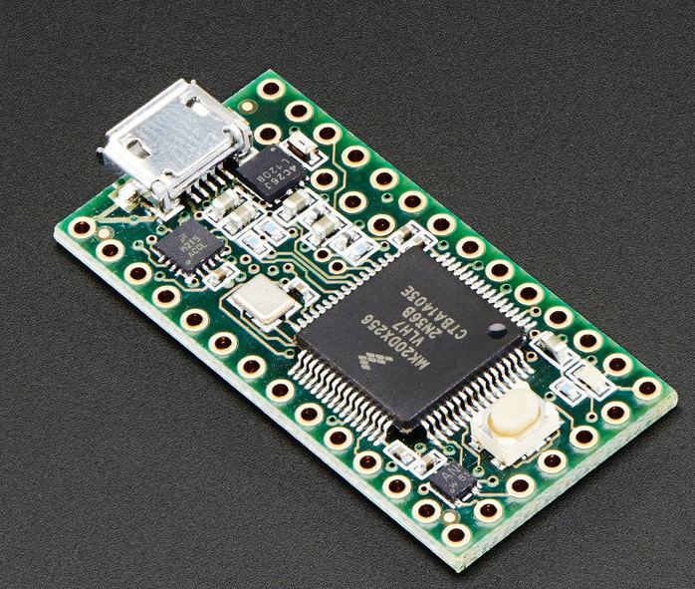
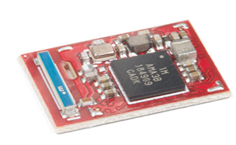
Teensy and Other Small Variants
Arduino like IDE and programming.
Many with Analog I/O.
Very small and low power.
More difficult to prototype with.
ADC lower resolution and slow. Difficult to do audio speeds.
Need to get a Wi-Fi/BT version in advance, or add on for IOT
Teensy 3.2
Adafruit
Circuit Playground
SparkFun Artemis

Slide 6
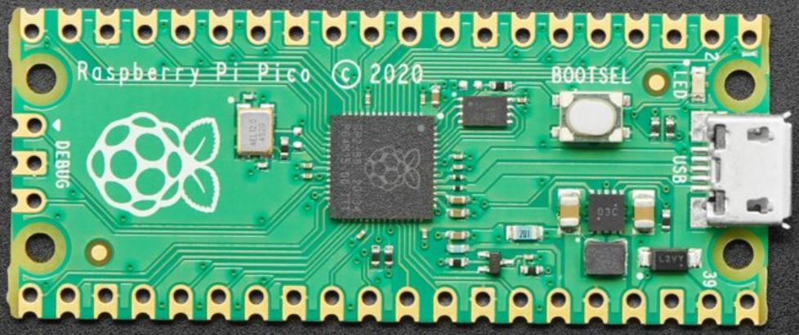
RP2040 – Raspberry Pi Pico
Dual ARM Cortex-M0+ @ 133MHz
264KB RAM 2MB Flash
CircuitPython, MicroPython, C/C++
30 GPIO pins
4 analog inputs
2 UARTs
2 SPI controllers
2 I2C controllers
16 PWM channels
Need to get additional screen for display.
ADC lower resolution and slow. Difficult to do audio speeds.
No Wi-Fi/BT need add on for IOT
Currently no Arduino IDE support.

Slide 7
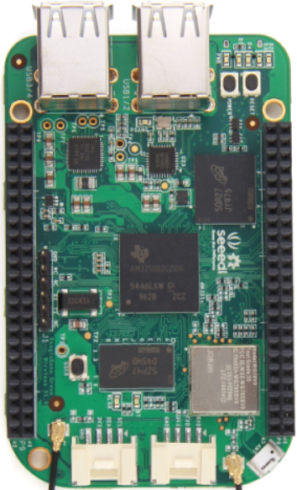
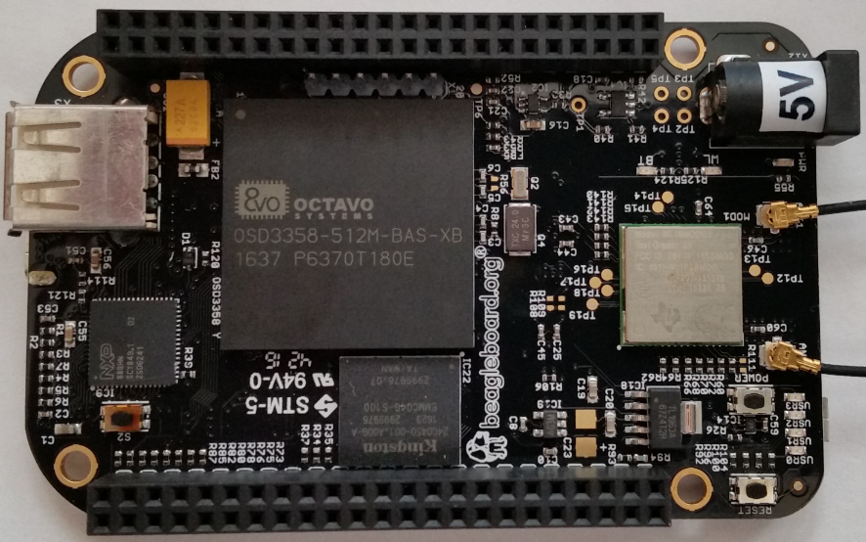
BeagleBone
Advantages
Linux operating system. Can program in many languages and interact with the internet.
Can make Webpages and run full LAMP stack.
Open-source software and hardware support.
Fast ARM core processor.
The Black Version has a micro-HDMI display.
Analog inputs!!!
Disadvantages
Display resolution not that good.
Single Core ARM Processors.
Operating system overhead.
Costs more than Raspberry Pi
Community support is not as wide as Raspberry Pi
Operating system and Overlays not stable.

Slide 8
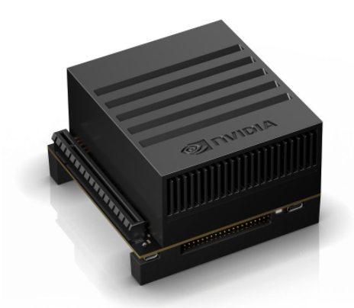
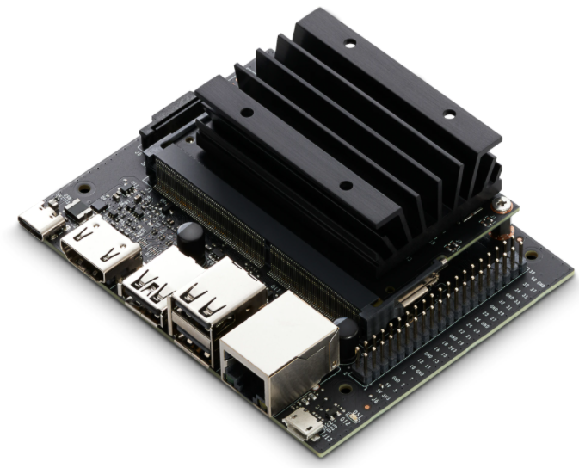
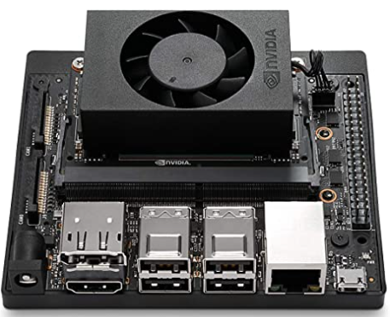
Nvidia Jetson Family
Advantages
Ubuntu Linux Operating System
Open-source software and hardware support.
Industrial use and quality
Fast ARM core processors and GPU.
Uses same 40 pin connector as Raspberry Pi.
Disadvantages
Cost for higher end units >$300.00
Need to add on hardware for Analog inputs.
Power hungry when compared to other micro controllers.
Operating system overhead.
40 pin connector rotated 180 degrees from Raspberry Pi.
AGX $599
Nano $59
NX $399

Slide 9
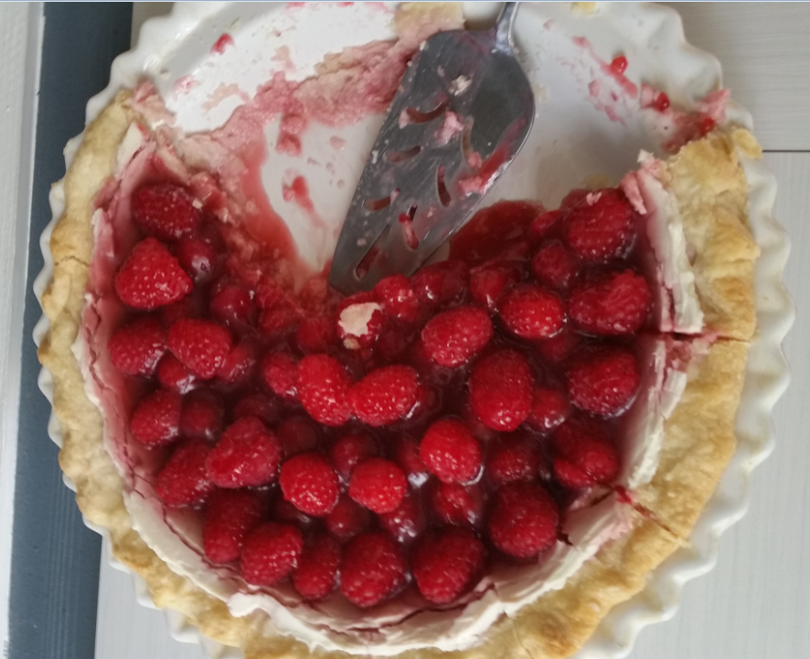
Time to talk about Raspberry Pie

Slide 10
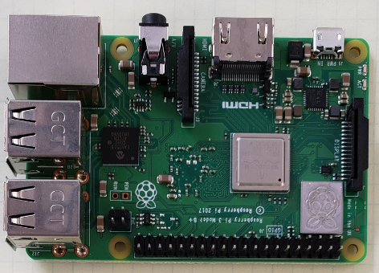
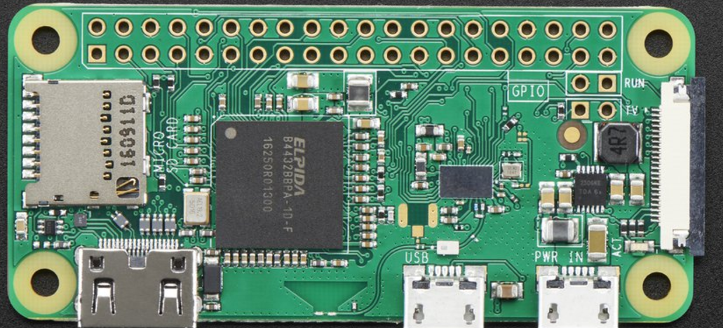
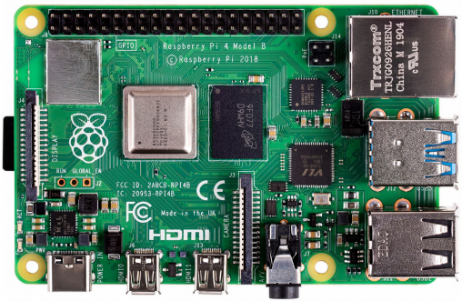
Raspberry Pi
Advantages
Linux operating system. Can program in many languages and interact with the internet.
Can make Dynamic interactive Webpages and run full LAMP stack.
Massive open-source software and hardware support.
Very fast ARM core processor.
Easy to implement GUIs for interactive programs.
Disadvantages
Need to add on hardware for Analog inputs.
Power hungry when compared to other micro controllers.
Operating system overhead.
Heat dissipation on newer versions

Slide 11
Difference between the Raspberry Pi Versions
Model | B | B+ | Pi 2 | Zero/W | Pi 3 A+ | Pi 3+ | Pi 4 | Pi 400
CPU | Arm 6 700MHz | Arm 6 700MHz | 4xArm 7 900MHz | Arm 6 1000MHz | 4xArm 53 1400MHz | 4xArm 53 1400MHz | 4xArm 72 1500MHz | 4xArm 72 1800MHz
RAM | 512MB | 512MB | 1GB | 512MB | 512MB | 1GB | 1GB/2GB/4GB/8GB | 4GB
USB | 2 | 4 | 4 | 1 | 1 | 4 | 2-2.0 2-3.0 | 1-2.0 2-3.0
Network | 10/100 | 10/100 | 10/100 | None/Wi-Fi | Wi-Fi | 10/300 Wi-Fi abg | 10/100/1G Wi-Fi abg | 10/100/1G Wi-Fi abg
Video | HDMI/NTSC/PAL | HDMI/NTSC/PAL | HDMI/NTSC/PAL | HDMI | HDMI/NTSC/PAL | HDMI/NTSC/PAL | 2xHDMI NTSC/PAL | 2xHDMI
Hardware IO | 17 | 25 | 25 | 25 | 25 | 25 | 25 | 25
+5V Supply | 1A | 1A | 1.5A | 500mA | 1A | 2.5A | 3.0A | 3.0A
Bluetooth | No | No | No | Yes/W | Yes | Yes | Yes | Yes
SD Card | Mini | Micro | Micro | Micro | Micro | Micro | Micro | Micro
Cost | $30 | $25 | $35 | $5/$10 | $25 | $35 | $35/$45/$55 | $70

Slide 12
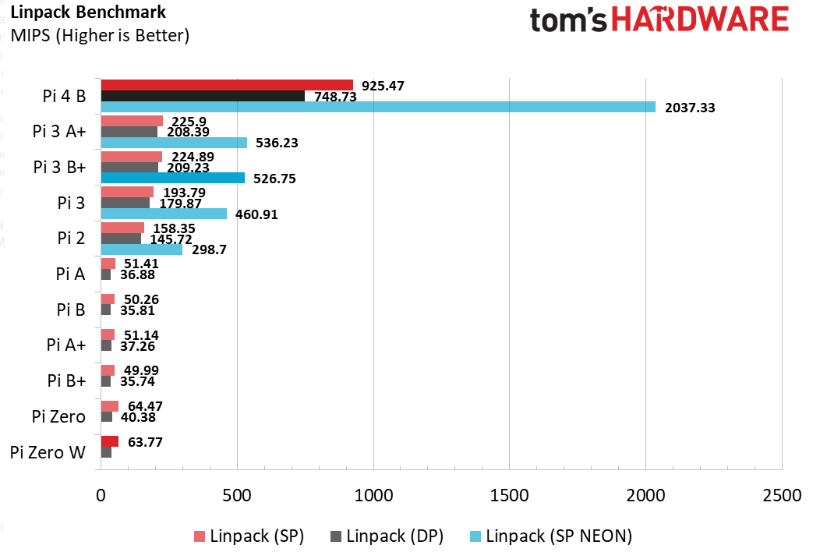
CPU Speed Benchmarks

Slide 13
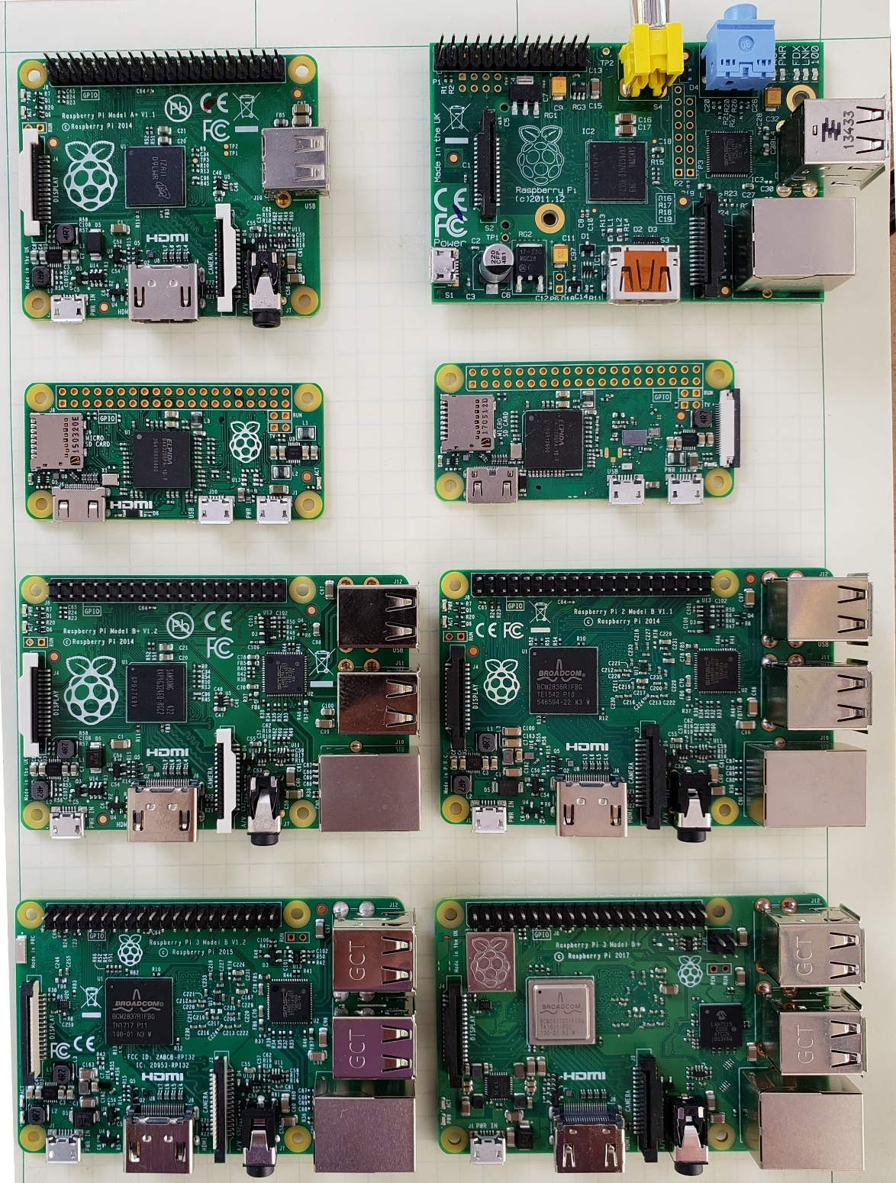
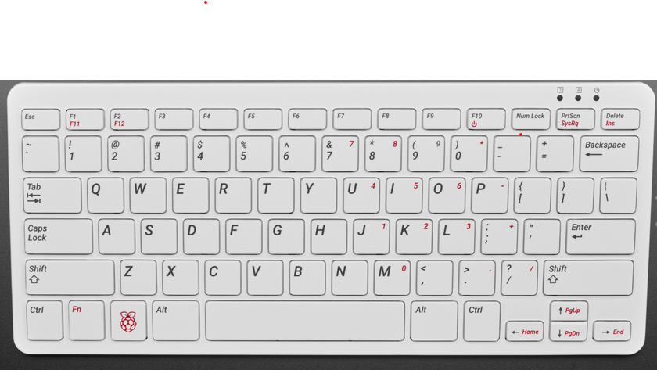
Which Pi Do you have?
A+
B
Zero
Zero W
Pi 400
B+
Pi2
Pi4
Pi3
Pi3+

Slide 14

Some Raspberry Pi Resources
TM Raspberry Pi Foundation www.raspberrypi.org
Good Links and web sites:
www.raspberrypi.org —The Foundation’s Website
www.raspberrypi.org/downloads — Various Raspberry Pi Operating Systems
https://elinux.org/RaspberryPiBoard - Raspberry Pi Wiki Pages
www.tomshardware.com – Good Linux and Pi tutorials and reviews.
www.adafruit.com — Adafruit very good site for parts and tutorials
learn.adafruit.com/category/raspberry-pi —Many projects and how to’s at Adafruit
www.sparkfun.com —Raspberry Pi parts and many other Hobby parts. (Colorado Co.)
www.newark.com —Low priced Raspberry Pi Parts
www.microcenter.com —Online and In Store Raspberry Pi
www.instructables.com/howto/Raspberry+Pi/ Lots of good Pi Tutorials
https://github.com/Chuckduey/CSU_Pi_Class.git GitHub page with the code from this class.
My email cduey@msn.com

Slide 15
Important Raspberry Pi Tips
Do Not add or remove hardware while running. Including USB devices. Plugging in heavy load on the USB at the last minute can kill the SD card.
Power down the Raspberry Pi using a software command before removing power. SD corruption is very common on uncontrolled power downs.
SD cards are fragile and wear out. Keep a backup copy of your code. It is best to store it on a network drive.
SD cards come in various speeds and sizes. Class 10 is the fastest. For the Older than version 3, Raspberry Pi SDHC 32GB is the maximum sized. For the Newer Pi’s 256GB SDXC can be used.
The Raspberry Pi I/O ports are 3.3V. A 5V signal will render the port, and possibly the whole Pi useless.
The Micro SD cards are very easy to pop out accidentally. If it does while it is running, resist the temptation to plug it right back in. Power down first!!!

Slide 16








Raspberry Pi Raspbian (Debian) Versions
Initial Release Date | Current Release Name | Debian Version | Linux Kernel | GCC | apt | X Server | Raspberry Pi 1/1+ | Raspberry Pi 2 | Raspberry Pi 3 | Raspberry Pi 3+ | Raspberry Pi 4 | Raspberry Pi 400
2013-09-27 | 2015-05-05 | 7 (Wheezy) | 3.18 | 4.7.2 | 0.9.7 | 7.7
2015-09-28 | 2017-07-05 | 8 (Jessie) | 4.9 | 4.9 | 1.0.9.8.1 | 7.7
2017-09-08 | 2019-04-08 | 9 (Stretch) | 4.14 | 6.3 | 1.4.9 | 7.7
2019-06-24 | 2021-05-07 | 10 (Buster) | 5.10.17 | 8.3 | 1.8.2.3 | 7.7
Bullseye
Buster
©

Slide 17
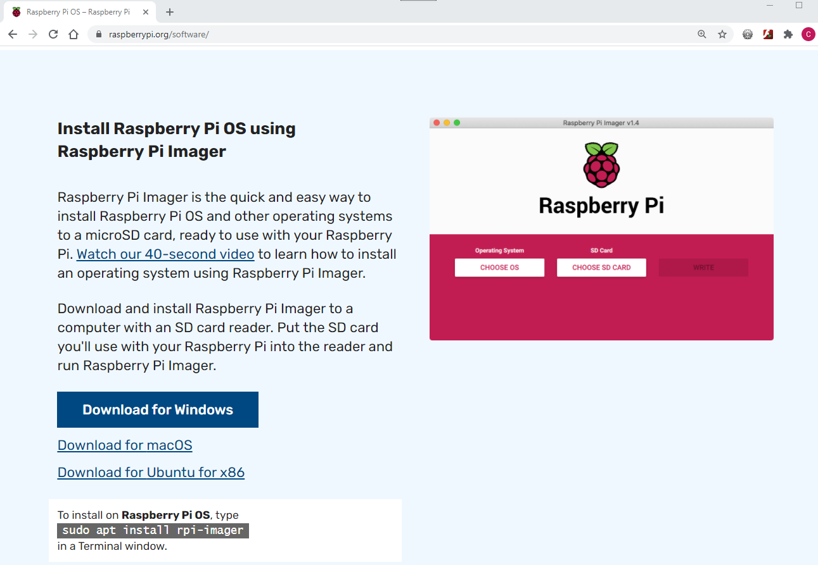
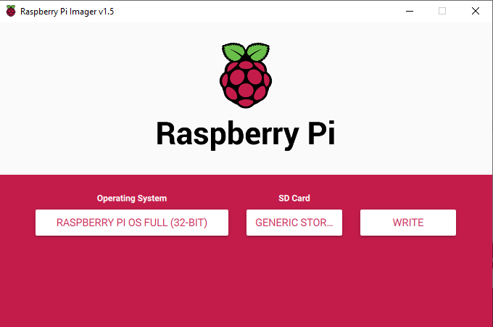
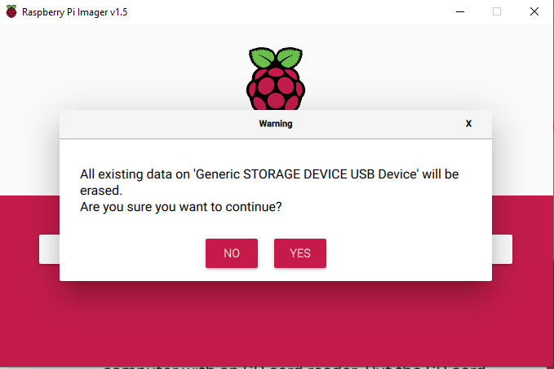
How do you create SD Card Images
www.raspberrypi.org/software/

Slide 18
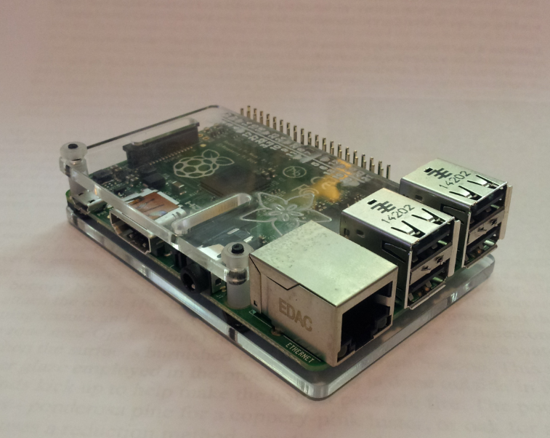
Connections for your Raspberry Pi
10/100/1000 Network
3. Power
1. HDMI
2. USB
Audio/Analog Video

Slide 19
Hook up your Raspberry Pi
Round up the components. Pi, HDMI cable and display, power supply, power cable, USB mouse and USB keyboard.
Plug in the HDMI to the display and Raspberry Pi.
Plug in USB mouse and keyboard.
Plug in power cable on Raspberry Pi end, and then plug in power.
Watch HDMI display and make sure it is booting.
If it is not booting unplug power and check the SD card.
Do not Plug in or remove hardware components while the Pi is powered! It can cause flash corruption.
To prevent SD card corruption, use the Power Down via GUI or “sudo poweroff”

Slide 20
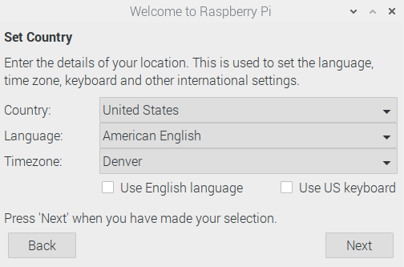
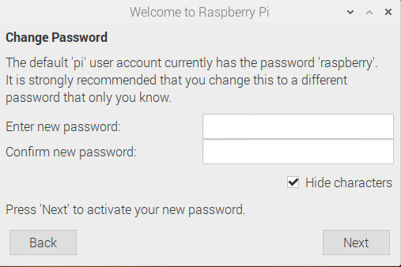
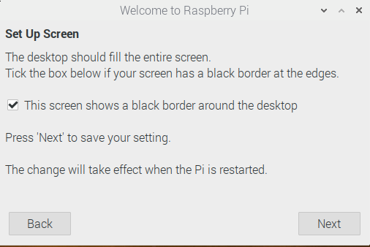
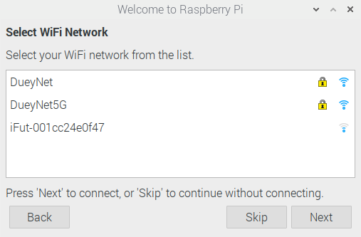
Install Raspian
!
Do not use the Default password. You will be hacked!
Set US Keyboard!

Slide 21
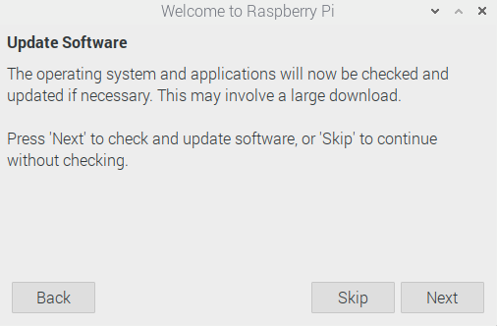
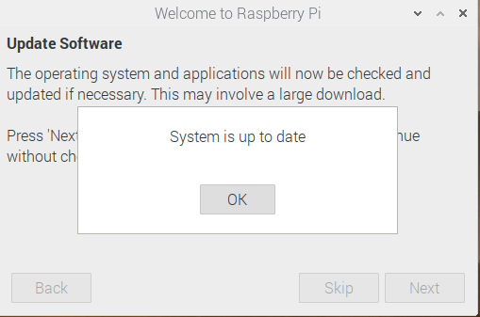
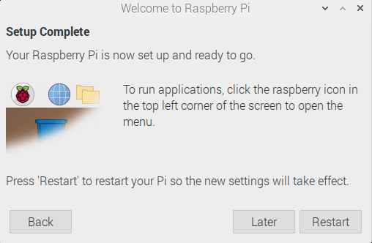
More installation
Takes 5 minutes ->

Slide 22
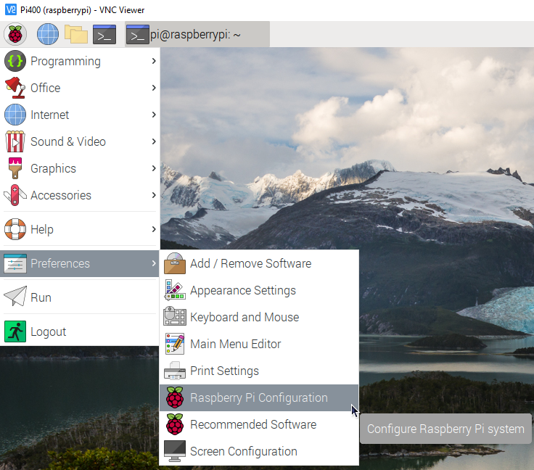
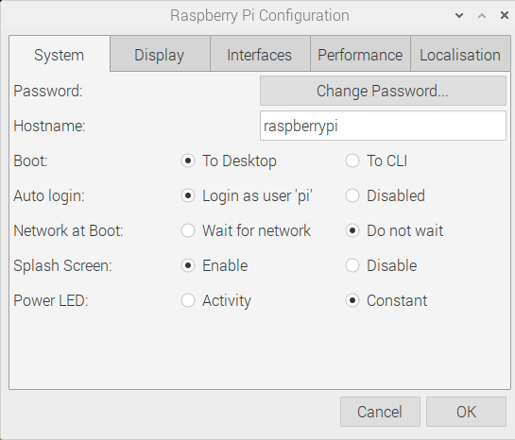
After Reboot

Slide 23
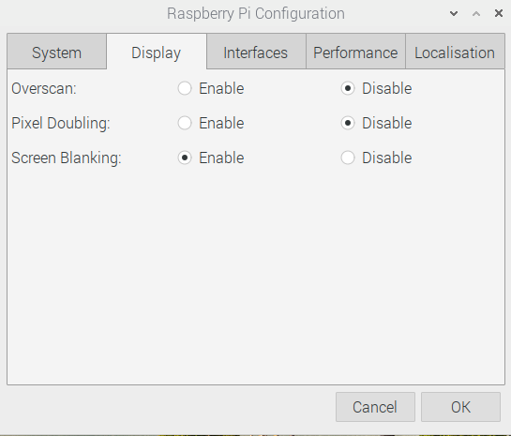
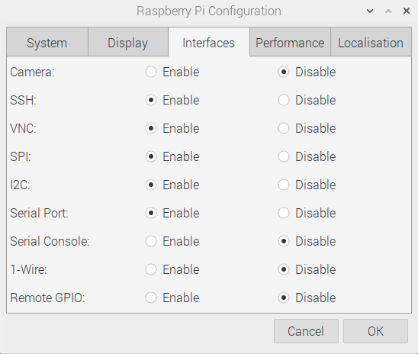
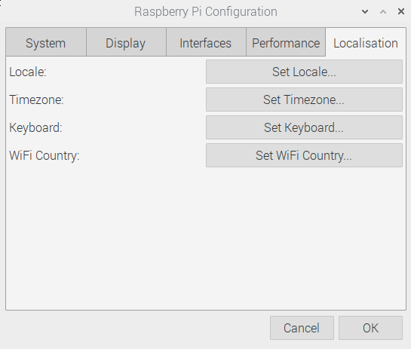
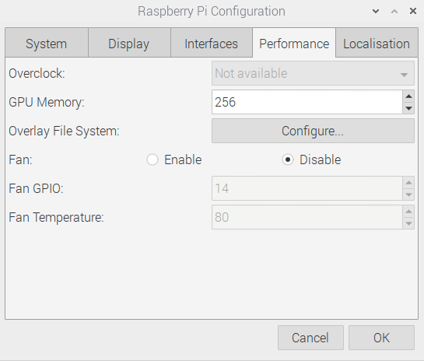
More Configuration
Camera if you have one
SSH for PuTTY and to transfer files
VNC for remote desktop
SPI for Fast Serial HW
I2C For slower serial HW
Serial Port for HW serial
Serial Console
1-Wire Single wire HW
Remote GPIO
If the keyboard or Time Zone is not set correctly
For systems with more the 2GB RAM – Increase GPU Memory

Slide 24
Useful Tools
Linux or MAC computer with USB and network.
With a Linux computer, it makes it easy to copy, change and back up Raspberry Pi SD cards using the “dd” command.
Also, the ssh, and ssh –X makes it easy to remote in to work.
Win32 Disk Imager - A perfect tool copying and backing up Raspberry Pi SD cards. Do not do a direct SD to SD copy.
PuTTY - creates a terminal window that can be used to “ssh” to any Linux computer on you network from a windows machine.
VNC/ RealVNC – VNC can display a desktop to another computer Linux or Windows. Very nice for remote work from different platforms.
USB power 3.0A or more - While most computers are limited to 500mA of current on the USB port, it is easy to have more that that draw from a Raspberry Pi with accessories.

Slide 25
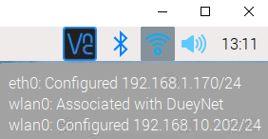
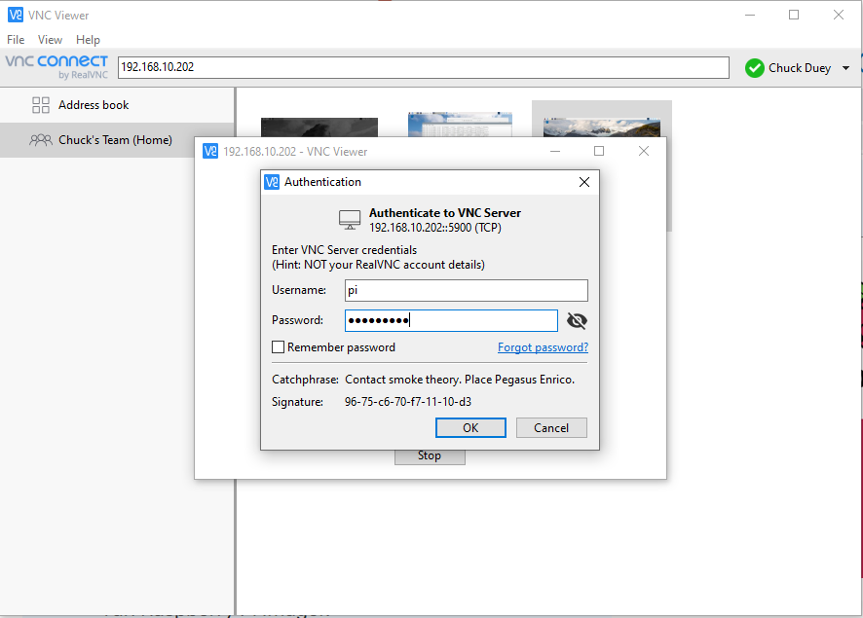
VNC – Remote access desktop
https://www.realvnc.com/en/connect/download/viewer/ - Download a viewer
Hover over network symbol in upper right to find address

Slide 26
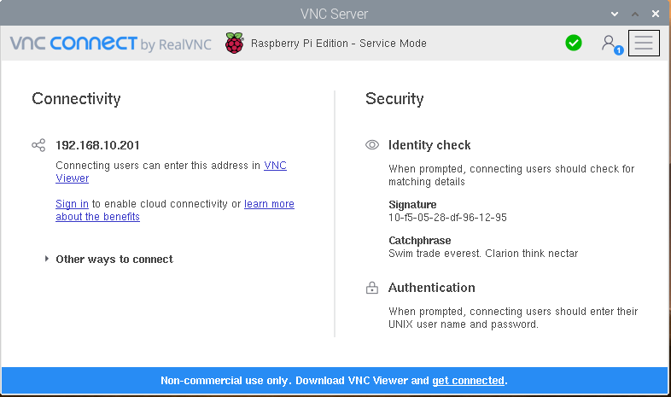
VNC to Your Pi from Anywhere
For Remote access set up an account. https://www.realvnc.com/en/raspberrypi/
Sign in once an account is created

Slide 27
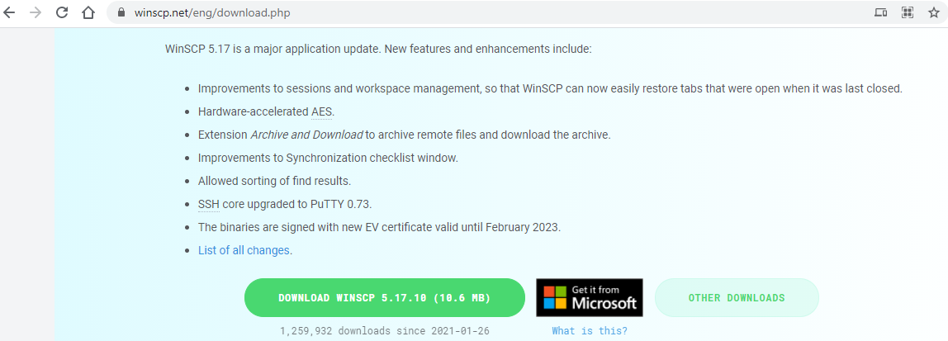
WinSCP
https://winscp.net/eng/download.php

Slide 28
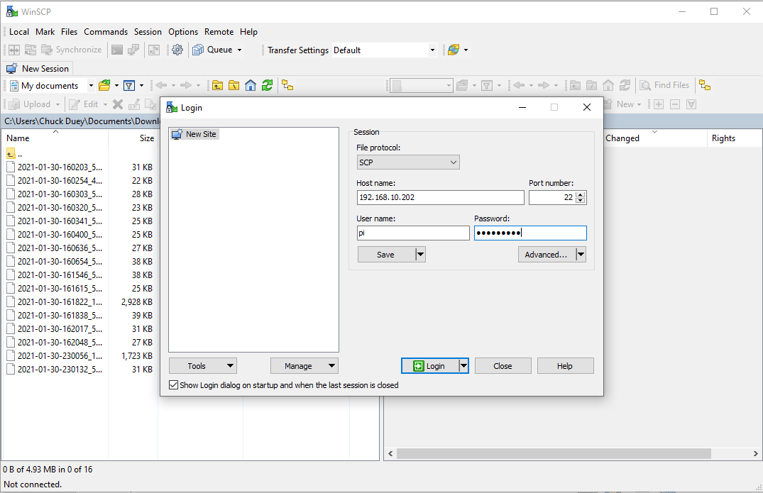
Using WinSCP
Set to SCP
IP Address of Pi

Slide 29
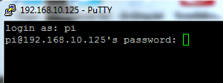
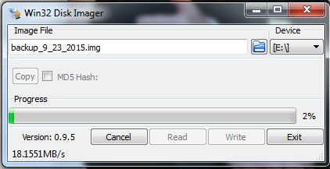
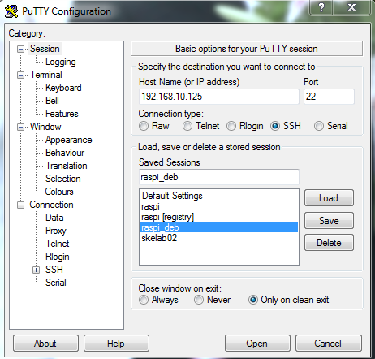
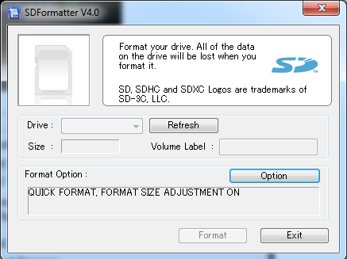
Other Useful Windows Tools

Slide 30
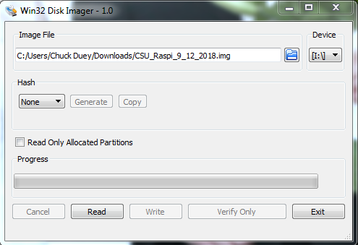
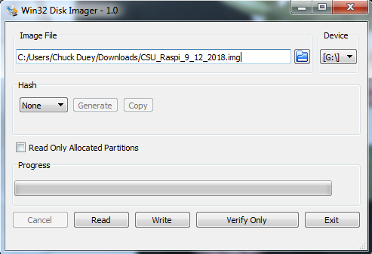
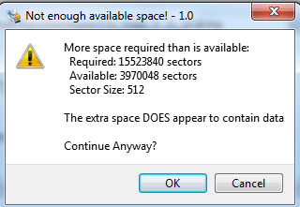
Quick Word on SD Cards They are not all the same.
Backup your files!!!! SD Cards will get corrupted.
When you copy an image, actual SD card size can vary by more than a GB. To burn to a new card the image size or bigger is needed! Both Windows and Linux copies will have this problem
If Linux dd is used, make sure to copy the root image. /dev/sdX not /dev/sdX0,1..

Slide 31
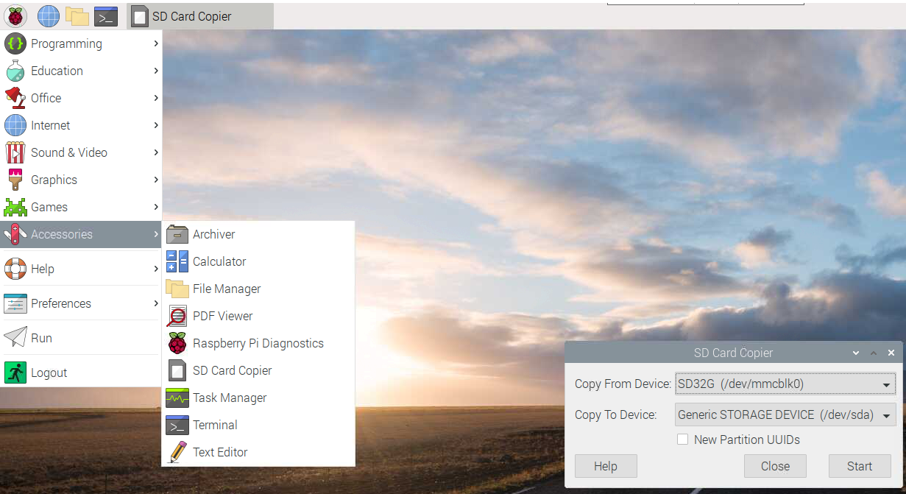
New Backup Tool SD Card Copier
Make a backup of your system. Copy From /dev/mmcblk0 never to!
While the copy is running close all other applications and do not make any changes to the file system.

Slide 32

Raspberry Pi Raspian Buster

Slide 33

Terminal Window
Click here once

Slide 34
Terminal window commands
https://www.tomshardware.com/reviews/raspberry-pi-command-line-commands,6159.html
ls = list files in directory ls –l = List long ls –a = List all
cd (dir name) = change directory
df –h = Show file systems sizes and usage
nano (file) = Simple intuitive text editor
vi (file) = Simple powerful non-intuitive text editor.
cat (file) = output the contents of a file
less (file) = output a file one page at a time
apt install (package) = get a package to install
apt update = update packages
apt-cache show (key word) = show available packages
sudo = next command execute as root
ifconfig = show the ip interface connections

Slide 35

Ways to get applications and software packages
apt-cache search [package]
sudo apt install [package] octave, mysql, git, python-pip…
pip3 install ‘Some Application’
git clone git://[package site] git.osmocom.org/rtl-sdr-git
Download “tgz” file. tar –xzf package.tgz

Slide 36



*Connect to internet and download package
Verify Connection to Wireless
Open a web page to www.google.com
Open a terminal and “apt-cache search spice”
sudo apt install oregano
<- install oregano spice simulation program ->

Slide 37


Alterative GUI method Preferences -> Add/Remove Software
Channel1

Slide 38



*GitHub Collaboration Tools
https://github.com/Chuckduey/CSU_Pi_Class
Left Mouse Click
git clone <Center Click>
git pull
This will get the latest release of the files.

Slide 39
GitHub – Great Collaboration Tool
For opensource projects it is Free.
Size limit is 500MB, and no file bigger than 100MB.
You can start a repository and control who can change it.
Changes can be made and tracked.
Branches of code and Tags can be generated.
Private Repos and Closed Repos can be made but require a monthly fee.
It is a great way to have an opensource project with collaboration.
A good basic class on GitHub:
https://www.coursera.org/learn/introduction-git-github

Slide 40

Example of GitHub Desktop

Slide 41

*Geany – A Good Generic Programming IDE

Slide 42

*Hello World! Geany Python
Change the code, save and run it.

Slide 43

*Hello World! Geany C
Compile the code
Build
Then Run it

Slide 44


*Hello World! Geany HTML
Change the code, save and run it.

Slide 45
Raspberry Pi I/O*
GPIO – General Purpose I/O
Good for LED and Relay Control
Input good to sense buttons and switches
UART/Serial – 2 Wire interface 3.3V
Good for GPS, RS-232 Monitor, and many others.
Baud rates up to 115200 bps
SPI Serial 4 Wire interface. (MOSI, MISO, SCLK, CE) 3.3V
2 Chip Selects built in. Easy connections to many serial sensors.
Speeds can be between 8KHz to 125MHz (1MHz default)
This can be used to run an LCD Screen
I²C Serial 2 Wire Interface. (SDA, SDL) 3.3V
Multiple devices with 7-bit address. Up to 127 - 11
Much slower 400Kbps For Raspberry Pi.
Great for touch screen sensors.

Slide 46


*GPIO Pin out
Note: GPIO pins are 3.3V Only
A 5V input will cause damage to the Raspberry Pi!!!
Note: for Raspberry 4B version 2.52 GPIO is needed
wget https://project-downloads.drogon.net/wiringpi-latest.deb
sudo dpkg -i wiringpi-latest.deb

Slide 47

*Standard Raspberry PI GPIO functions
-g
-g
looper.sh >>>
#!/bin/bash
gpio mode 7 out
while true; do
gpio write 7 1
sleep 0.5
gpio write 7 0
sleep 0.5
done

Slide 48


Add on Hardware
USB:
SDR Radios – Can receive AM, FM, SSB, Aircraft and Satellites
GPS – add precise time and location.
Instrument control. – Control Lab meters, oscilloscope and more.
Connect to Arduinos or other embedded devices.
DSI Interface – Raspberry Pi unique interface.
Camera – right now up to an 8M pixel camera. Full color or No IR.
Display – Very nice 7” touch screen is all that is supported now.
Hats – 40 pin interface to hardware.
Best way to get ADCs and DACs.
Many control boards for relays and LED signs
With ADC’s, DAC’s and GPIO expanders a brewery controller.
STEMMA / Qwiic Hat adapter for I2C prototyping

Slide 49

Touch Screen with Camera and Case
Addon Hardware
https://www.adafruit.com/product/4377

Slide 50



Addon Hardware Pi Camera – uses built in port.
Addon Hardware

Slide 51




Pi Hats – Hardware for the Raspberry Pi
Adafruit Proto Bonnet
Pimoroni DAC Bonnet
Adafruit OLED Bonnet

Slide 52




Franken Chiller Brewery Control

Slide 53


Raspberry Pi Sense Hat

Slide 54

Accelerometer.
Hit Run and tilt the Pi

Slide 55

Weather station
Inside Geany open the MiniWeatherStation.py

Slide 56

Copy and pasting between windows.
In a terminal window type: python3
Select from Geany, go to Python window and center click:
>>> from sense_hat import SenseHat
>>> sense = SenseHat()
>>> sense.clear()
>>> sense.show_message(“Your Message”, text_colour=[255, 0, 0])
>>> dir(sense) - Will show all the “methods” the sense object has
When done.
>>> exit()
<Center Click>

Slide 57


Sense Hat – Chuck Maze
Use Default Maze

Slide 58



GUIs via Python Tkinter, matplotlib, Pygame, GTK+ and Qt

Slide 59


Pi Sense Hat – Chuck Paint

Slide 60

STEMMA QT (Adafruit) and Qwiic (SparkFun)
Here's an example of a STEMMA QT sensor board. You can use it with any Qwiic board or device!
Plugging in the sensor is easy, you just need to connect a JST-to-JST cable. So for example, you can make a IoT plant monitor with two parts connected in series with no soldering or special wiring.
So, for smaller I2C devices, we'll use the JST SH that SparkFun Qwiic uses, so that Qwiic & STEMMA QT sensors are cross-compatible!
STEMMA QT devices keep the level shifting/regulator, so you can use STEMMA QT with Grove/Gravity/STEMMA/Qwiic controllers at any voltage range, safely!
From: https://learn.adafruit.com/introducing-adafruit-stemma-qt/what-is-stemma-qt

Slide 61




Looking at the I2C bus
i2cdetect –y 1 This shows the devices on Bus 1
i2cdump –y 1 0x5f Will dump the registers of device 0x5F
I2cget –y 1 0x5f 0x10 Will get register 16 (0x10) of device 0X5F
I2cset –y 1 0x5f 0x10 0x3f Will get register 2 of device 0X5F

Slide 62

Hookup the SGP30 *** Note power off while changing wires!!!

Slide 63


After power on check i2cdetect and run sgp30.py

Slide 64
Thanks !!! Have Fun With Raspberry Pi
Code is available at https://github.com/Chuckduey/CSU_Pi_Class.git

